Slide 1
First do the file
‘Do_Last_This_Was_Lesson 9_Streams_D’
This current file is referenced inside
that one at the end.

Slide 2
A closure is a functor embedded inside another class, that is capable of remembering the state of its enclosing object.
A closure in Java can be defined to be a lambda expression, together with the values of the free variables that are captured by the lambda expression.

Slide 3
TECHNICAL NOTE: Although every lambda is a realization of a functional interface, the way in which the Java compiler translates a lambda into a realization of such an interface is not obvious. Historically, the possibility of simply translating the lambda into an anonymous inner class was considered by the Java engineers, but was rejected for a number of reasons. One reason is performance – inner classes have to be loaded separately by the class loader. Another is that tying lambdas to such an implementation would limit the possibility for evolution of new features of lambdas in future releases. You can verify that lambdas and

Slide 4
anonymous inner classes are fundamentally different (even though very similar) by considering how the implicit object reference `this’ is interpreted by each type: In an anonymous inner class, `this’ refers to the inner class; in a lambda, `this’ refers to the surrounding class. See http://www.infoq.com/articles/Java-8-Lambdas-A-Peek-Under-the-Hood

Slide 5
What Are Streams and Why Are They Used?
What They Are. A stream is a way of representing data in a collection (and in a few other data structures) which supports functional-style operations to manipulate the data.
From the API docs: A stream is “a sequence of elements supporting sequential and parallel aggregate operations.”
Streams provide new ways of accessing and extracting data from Collections.

Slide 6
Functional-style solution
final long count
= words.stream()
.filter(w -> w.length() > 12)
.count();
Advantages: i. Purely functional, so threadsafe ii. Makes no commitment to an iteration path, so more parallelizable iii. Declarative style – “what, not how” iv. With Java 8 it is easy to transform into a parallel processing solution
Notes:
Example of parallelizing stream processing: (on a multi-core processor, this is a real speedup)
final long count = words.parallelStream().filter(w -> w.length() > 12).count();

Slide 7
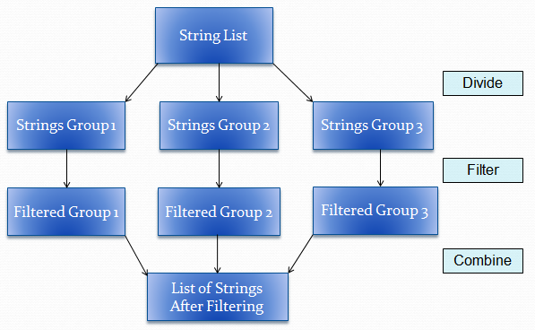
Parallel-processing solution
final long count
= words.parallelStream()
.filter(w -> w.length() > 12)
.count();
Notes:
Example of parallelizing stream processing: (on a multi-core processor, this is a real speedup)
final long count = words.parallelStream().filter(w -> w.length() > 12).count();

Slide 8
Facts About Streams
Java Implementation. The methods on the Stream interface are implemented by the class ReferencePipeline. The method implementations involve a combination of technical operations internal to the stream package.

Slide 9
Exercise 9.1
Use Stream's iterate method to produce a Stream consisting of all the odd natural numbers 1, 3, 5, . . .
Modify your solution so that your Stream consists of exactly these numbers: 9, 11, 13, 15. Print your Stream to the console (somehow)

Slide 10
Notes about comparing and thenComparing:
comparing is a static method of Comparator, and therefore cannot be chained
thenComparing is a default method so can be chained; it modifies current Comparator by introducing its compare method just when the current compare method returns 0.

Slide 11
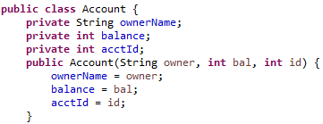
Use the comparing and thenComparing methods of Comparator to sort a list of Accounts first by balance, then by ownerName.
}

Slide 12
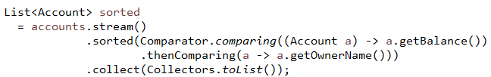
Solution

Slide 13
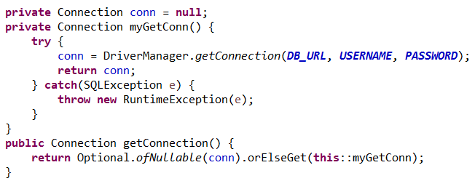
ofNullable used with orElse/orElseGet
When the orElse clause needs to obtain a value from a method call, use orElseGet instead.
Example. Use orElseGet as a way to implement a lazy singleton. The following is an example in which a Connection object (JDBC) is implemented as a lazy singleton within a ConnectionManager class.

Slide 14
Difference Between orElse and orElseGet
If orElse is used when a method call is needed, even if ofNullable encounters a non-null input, the method call in orElse will still execute, but the return value is ignored.
In the code on previous slide, if we write instead
public Connection getConnection() {
return Optional.ofNullable(conn).orElse(myGetConn()); }
then, when conn is not null, orElse will cause myGetConn() to be invoked, but will ignore its return value and return conn instead.
In the same scenario, the following code will not cause myGetConn to be invoked.
public Connection getConnection() {
return Optional.ofNullable(conn).orElseGet(()-> myGetConn()); }

Slide 15
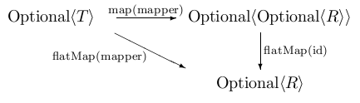
Using Optional : flatMap
The flatMap method works the same way as it does on Stream. It allows you to chain method calls and skip null checks. Given a mapper from type T to an Optional<R>, flatMap transforms an Optional<T> first to an Optional<Optional<R>>, then to an Optional<R>
mapper
T
Optional<R>
flatMap(mapper)
Optional<T>
Optional<Optional<T>>
Optional<R>

Slide 16
Optional
See Core Java page 259 - The Optional .flatMap method works in the same way (as the one in the Stream interface) if you interpret an optional value as a stream of size zero or one.

Slide 17
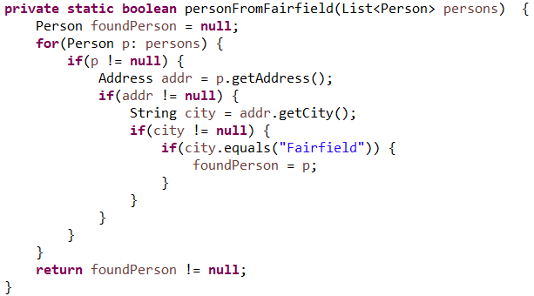
Example of Optional's flatMap
Consider ordinary code for seeing if a Person from Fairfield can be found in a list of Persons:

Slide 18
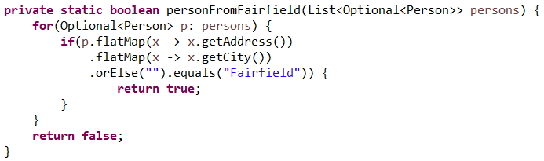
Using Optionals with flatMap completely eliminates these (unnecessary) null checks
Notes.
If an Optional opt is empty, opt.flatMap(mapper) returns an empty Optional
To get this nice behavior, you have to set up your classes so that they are using Optional. See Demo code
lesson9.lecture.optional_flatmap.usingoptionals.optionalway

Slide 19
Monads in Java 8
A monad is a special data structure, available in some languages, that serves as a wrapper class, to support various operations. In Java, these operations include filter and map. Monads are designed to support chaining operations, so that the output of each monad operation is another monad.
Monads are considered to be a key construct in functional languages
Every monad has a unit operation and a flatMap operation
More formal definition: Monads are chainable container types that trap values or computations and allow them to be transformed in confinement.
In Java 8, two monads were introduced:
Optional
Stream
Note: For Java's monads, the unit operation is of

Slide 20
Exercise 9.4
Use reduce to concatenate the Strings in the Stream below to form a single, space-separated String.Print the result to the console. See lesson9.exercise_4 in the InClassExercises project.
public static void main(String[] args) {
Stream strings = Stream.of("A", "good", "day", "to", "write", "some", "Java");
}

Slide 21
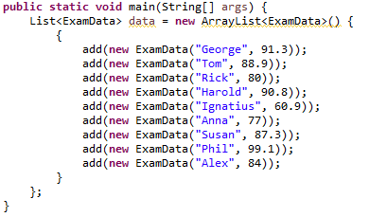
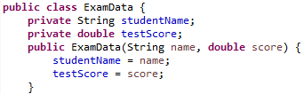
OPTIONAL - Exercise 9.5
Use DoubleSummaryStatistics to output to the console the top test score, lowest test score, and average among all test scores in a given list. See lesson9.exercise_5 in InClassExercises project.
}

